Slide 1

T
CUAI 추천 시스템 1팀
2025.07.29
발표자 : 정인혁

Slide 2
Content
The Recommendation Problem
How recommendations are made
How to implement the recommender system
Our focus

Slide 3

The Recommendation Problem
The problem of estimating ratings given by user to other items
$C$ : the set of all users
$S$ : the set of all possible items that can be recommended
$u$ : Utility function that measures the usefulness item to user
$u:C×S→R$
Choose such item $s^{′}∈S$ that maximizes the user’s utility

Slide 4
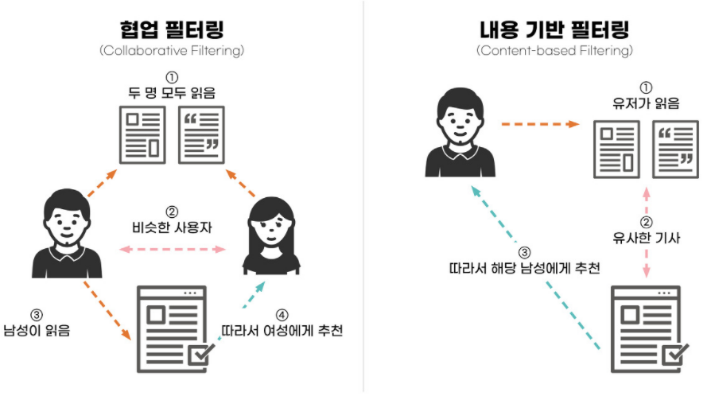
How recommendations are made
Content-based recommendations
Recommend items similar to the ones the user preferred in the past

Slide 5
How recommendations are made
Collaborative recommendations
Recommend items that people with similar tastes and preferences liked in the past

Slide 6
How recommendations are made
Hybrid approaches
Combine collaborative and content-based method

Slide 7
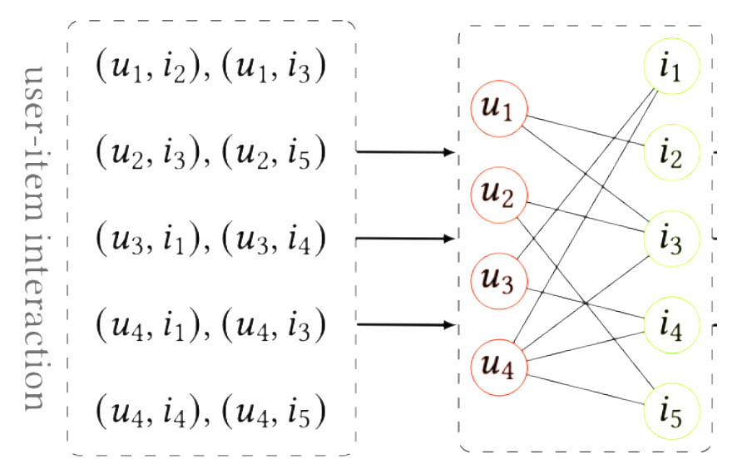
How to implement the recommender system
Graph-based recommender system
Can represent user-item relations to bipartite graph

Slide 8
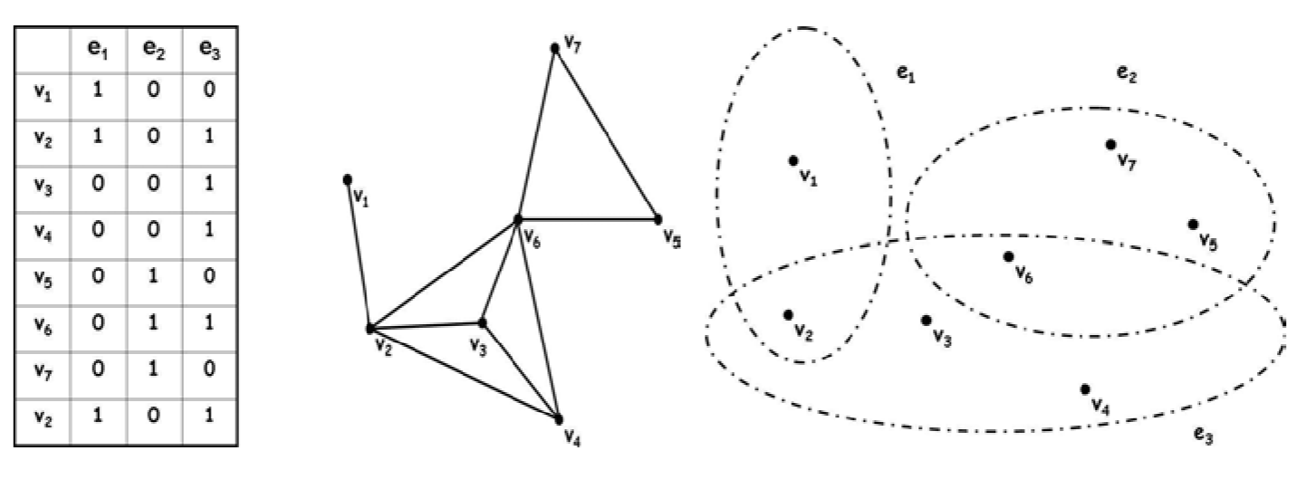
Our focus
Hypergraph
A graph in which an edge can connect more than two vertices

Slide 9
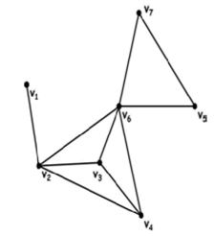
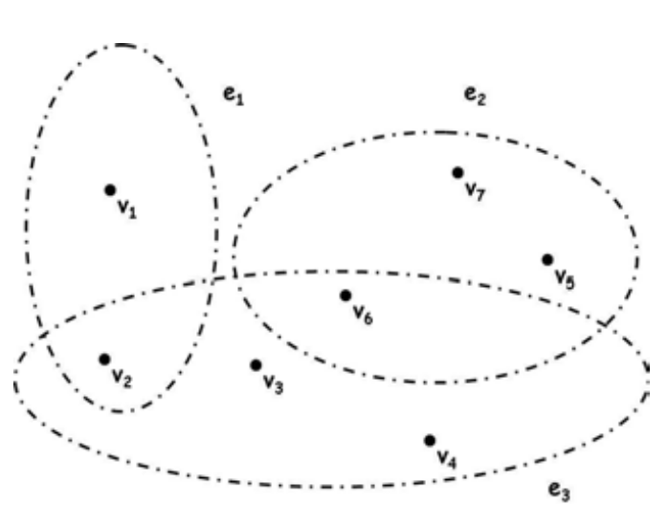
Our focus
Why the hypergraph is important?
Unable to recover hypergraphs from simple graphs

